Slide 1


K.RAMAKRISHNAN COLLEGE OF TECHNOLOGY
(AUTONOMOUS), TRICHY.
ATTENDANCE MANAGEMENT SYSTEM
PRESENTED
HEMCHUDESH A
2303811720521017
SUPERVISOR
Ms.S.UMA MAGESHWARI, M.E.,
AP/CSE.

Slide 2
PRESENTATION OVERVIEW
Objective
Project Introduction
Problem Statement
Methodologies (Programming concepts relevant to problem statement)
Architecture of the proposed system
List of Modules
Merits
Results and Discussion
Queries

Slide 3
OBJECTIVE
The primary objective of the Attendance Management System using Java is to provide an efficient, user-friendly platform for managing student attendance records. This system aims to streamline the process of recording, tracking, and analyzing attendance data. By automating attendance marking, report generation, and notifications, it reduces the administrative burden on educators, ensuring accurate and timely attendance records

Slide 4
PROJECT INTRODUCTION
An attendance management system is a crucial tool designed to streamline the process of tracking and managing student attendance in educational institutions. The system typically comprises a user-friendly interface, database integration, and backend logic to handle various functionalities, such as registering students, marking attendance, and generating insightful reports.

Slide 5
PROBLEM STATEMENT
In educational institutions, tracking student attendance is a critical yet often cumbersome task that requires significant administrative effort and precision. Traditional methods of attendance management, such as manual roll-calling and paper-based records, are prone to errors, inefficiencies, and data manipulation.

Slide 6
METHODOLOGIES
Classes and Objects:
A class is a blueprint or template for creating objects, defining the attributes and An object is instance of a class, representing a specific implementation of the defined blueprint.
Date and Time Handling:
Data handling refers to the process of storing, retrieving, and managing data efficiently in an application.
Exception Handling:
Exception handling is a mechanism for handling runtime errors in a program to ensure it runs smoothly and avoids unexpected crashes.
User Interface :
A GUI is a visual interface for interacting with a software application using graphical elements like buttons, text fields, and menus, instead of text-based commands.

Slide 7
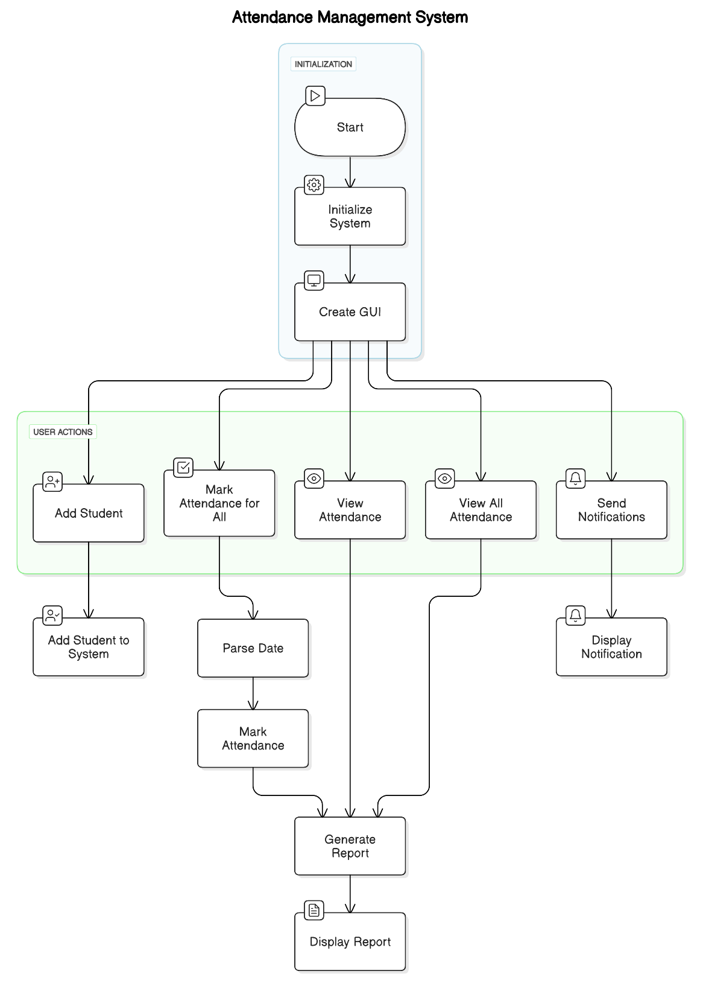
ARCHITECTURE OF THE PROPOSED SYSTEM

Slide 8
LIST OF MODULES
Student Module:
This class represents individual students within the system. It includes attributes like the student's name and an attendance record, which is a list of AttendanceRecord objects. The class provides methods to mark attendance, calculate the attendance percentage, and generate a report of the student's attendance.
Attendance Record:
This class holds the details of an individual attendance entry. Each AttendanceRecord object contains a date and a boolean value indicating whether the student was present on that date.
Attendance Management System:
This class manages the entire attendance system. It maintains a list of students and provides methods to add new students, mark attendance for individual students or all students, view attendance records, and send notifications for low attendance.

Slide 9
MERITS
Platform Independence Runs on any operating system with a JVM, ensuring compatibility.
Lightweight Framework Uses native OS components for faster rendering and better performance.
Simple API Easy to use for creating basic GUIs, ideal for small-scale applications.
Quick Development Rapid prototyping and implementation of user interfaces.
Event Handling Built-in event-handling mechanism for managing user interactions (e.g., button clicks).

Slide 10
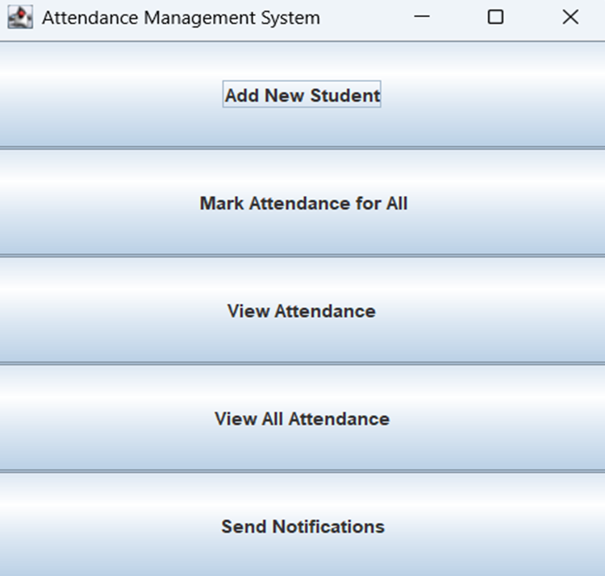
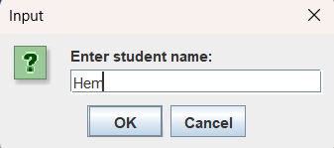
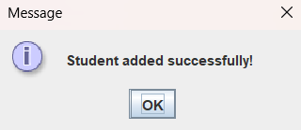
RESULTS AND DISCUSSION
2/7/20

Slide 11
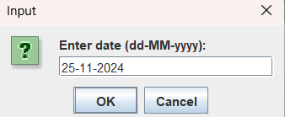
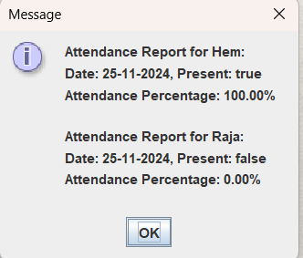
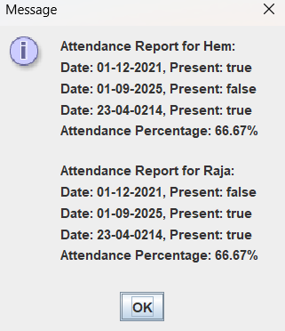
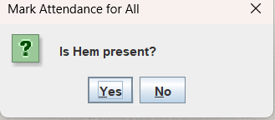
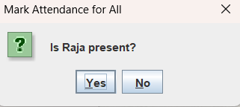
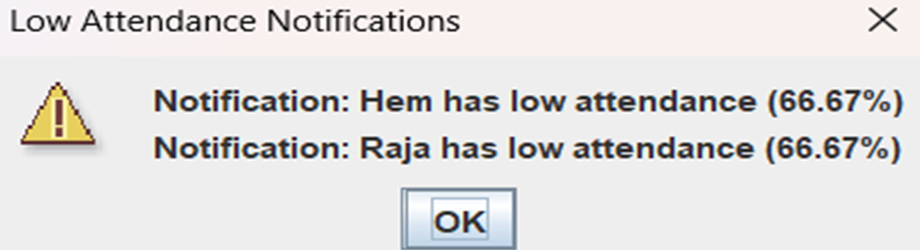
RESULTS AND DISCUSSION
2/7/20

Slide 12
QUERIES ?

